Slide 1
SSB Smart Speed Breaker
Team members
Abhay P A
Akshay K N
Jishnu N V
Yaswanth P S

Slide 2
INTRODUCTION
The problem faced in traffic by the traffic police and people has inspired the idea of SSB.
It is not just the speed breaker but a kind of automated traffic control system.
SSB is the product aimed to solve problems of systems like:
Speed bump
Speed table
Speed cushion
Actibump

Slide 3
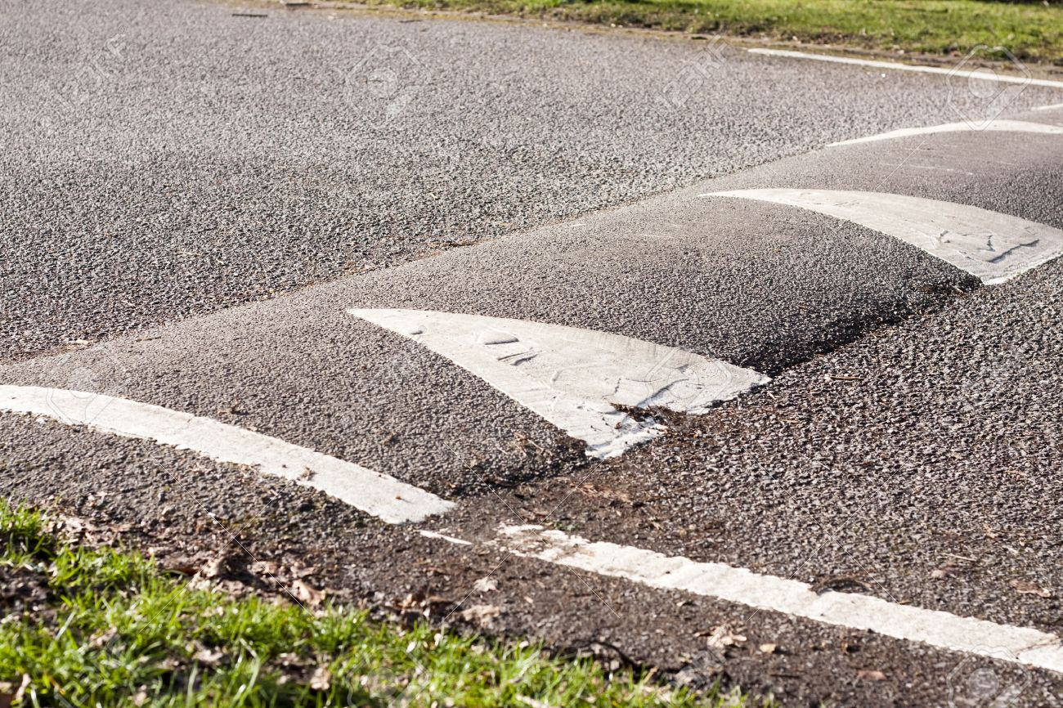
SPEED BUMB
Speed bumps (or speed breakers) are the common name for a family of traffic calmingdevices that use vertical deflection to slow motor-vehicle traffic in order to improve safety conditions. .

Slide 4
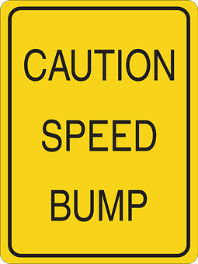
Pros
Reduces speed.
Diverts traffic to another streets, which is positive if the traffic is diverted from a local to a collector arterial street.
Speed and volume changes tend to remain over time.

Slide 5
PROS
Potential to reduce accident rates.
Fewer citizen complaints.
Increased safety.
Residents usually report that they are effective and generally support them.

Slide 6
Cons
May divert traffic to other local streets thus moving the problem.
Large trucks, buses and emergency vehicles must pass over the humps at a low speed or risk possible loss of control.
Humps require signing and striping; some residents object to these signs and markings as unattractive.
Noise levels increase at the hump due to deceleration/acceleration and the noise of a vehicle going over the humps.

Slide 7
CONS
Gutter running (swerving off road into gutter or sidewalk to avoid hump with some tires.)
Potential vehicle damage if traversed at high speeds.
Longer emergency vehicle response times possible.
Additional program to administer.
Initial construction and continuing maintenance costs.

Slide 8
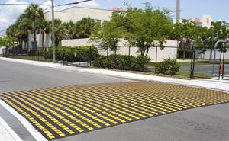
SPEED TABLE
Speed tables are midblock traffic calming devices that raise the entire wheelbase of a vehicle to reduce its traffic speed.
Speed tables may be used on collector streets and/or transit and emergency response routes.

Slide 9
Pros and Cons
Pros
Applicable to 2 way streets.
Relatively easy to maintaine
Cons
Speed tables should not be applied on streets wider than 50 feet.
Comparitively costly than speed bumps.

Slide 10
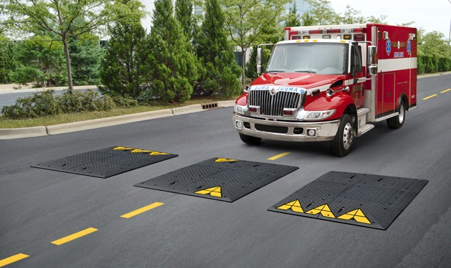
SPEED CUSHION
A speed cushion is a short, raised, rounded device, normally in the centre of a road lane.
Designed to be slightly wider than a car, so car drivers need to slow down.
Buses are wider than cars, so they can drive over speed cushions without passengers feeling anything.

Slide 11
Pros
Buses don't need to slow down
More effective than horizontal treatments at reducing speed
Emergency vehicles can travel drive more quickly over cushions than speed humps or tables
Can be avoided by cyclists
Drainage should not be affected

Slide 12
Cons
Cars drive considerably faster over speed cushions than speed humps or speed tables.
Bus companies and emergency services may oppose wider speed cushions (e.g. 1.7m wide) which are proven to be more effective at slowing down cars.
Some traffic is likely to transfer onto alternative routes, potentially causing a problem somewhere

Slide 13

ACTIBUMP
Actibump is a traffic safety system where speeding vehicles activate an inverted speed bumpintegrated into the road surface.

Slide 14
Pros
Automated system.
Only vehicles travelling above speed limit has to slow down.
Doesn't affect slow vehicles, lower count of deceleration.
Make people follow rules unconsciously.

Slide 15
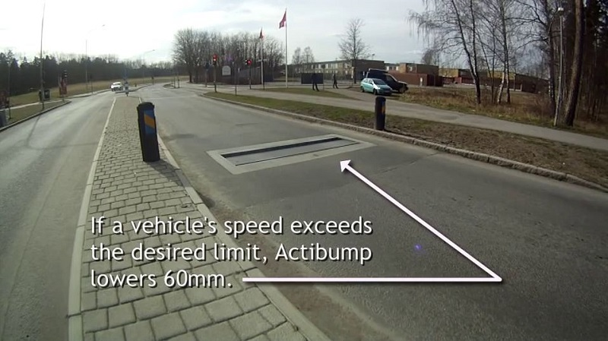
Cons
Higher initial cost.
No consideration for emergency vehicles.
Comparitively difficult to maintain.
Applicable only to oneway roads.
Two wheelers could easly pass over this.

Slide 16
Thank you….!

